Slide 1
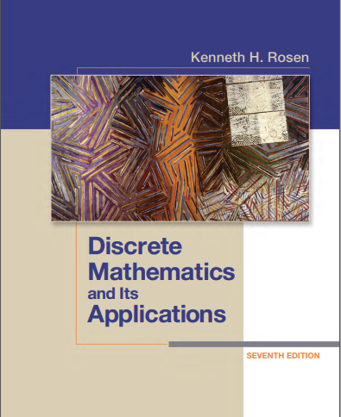

Discrete structures
By Dr. sajid iqbal
Course Reference Book

Slide 2
Rules of inference
Chapter - 1

Slide 3
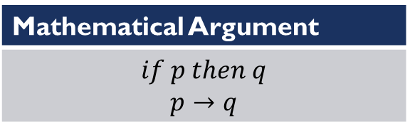
Background
A Proof in mathematics is a set of valid arguments that establish the truth of mathematical statements
Arguments establishes the Truth of claim
Statement: A proposition whose truth value is established with the help of valid argument
Argument: It is a proposition whose truth is established
Valid Argument: An argument that leads to truth of statement
Mathematical Proof
Statement | Arguments
Mathematical Argument
$$if p then q$$ $$p→q$$

Slide 4
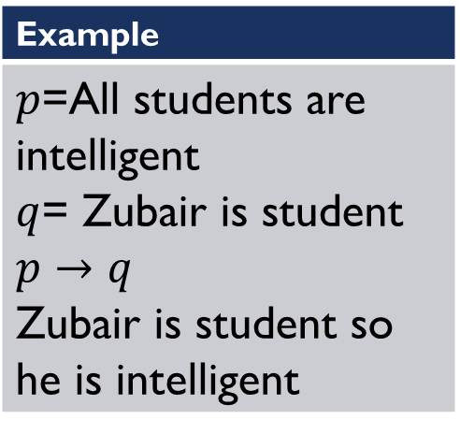
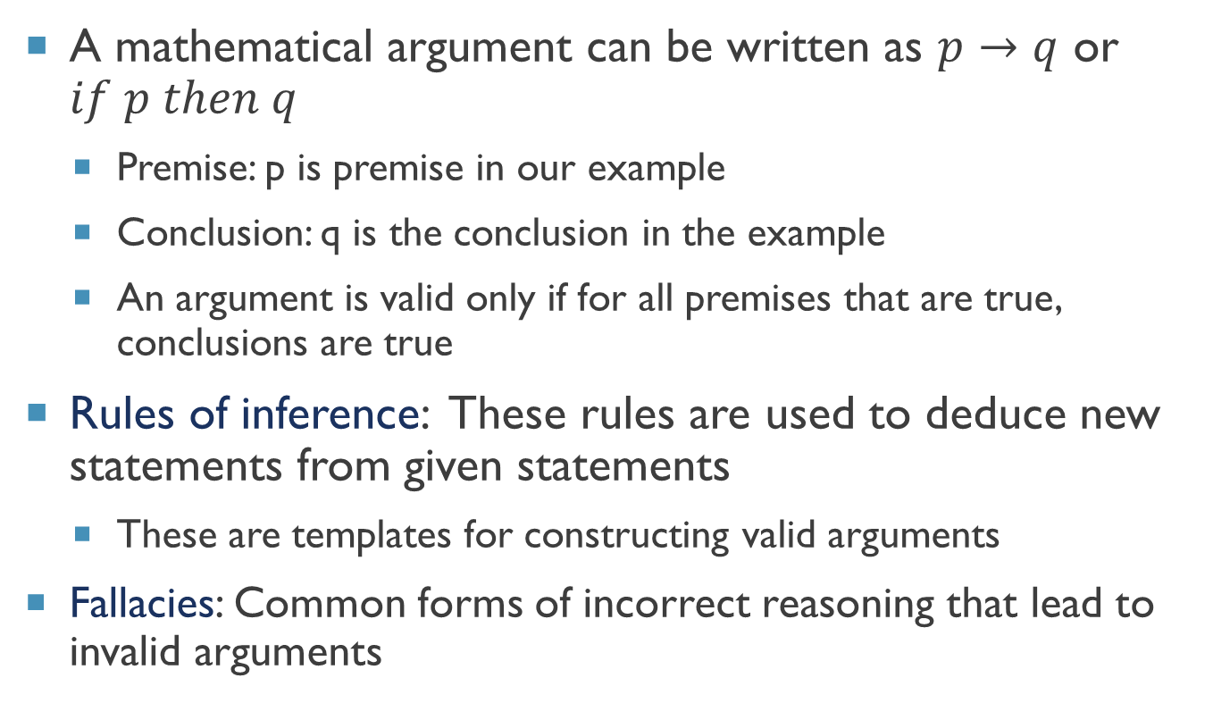
Background
A mathematical argument can be written as $p→q$ or $if p then q$
Premise: p is premise in our example
Conclusion: q is the conclusion in the example
An argument is valid only if for all premises that are true, conclusions are true
Rules of inference: These rules are used to deduce new statements from given statements
These are templates for constructing valid arguments
Fallacies: Common forms of incorrect reasoning that lead to invalid arguments
Example
$p$=All students are intelligent $q$= Zubair is student $p→q$ Zubair is student so he is intelligent

Slide 5
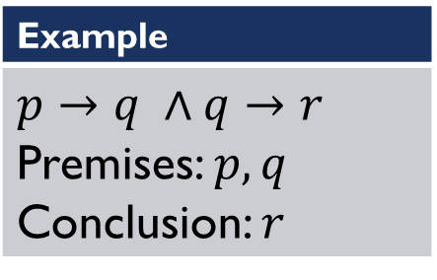
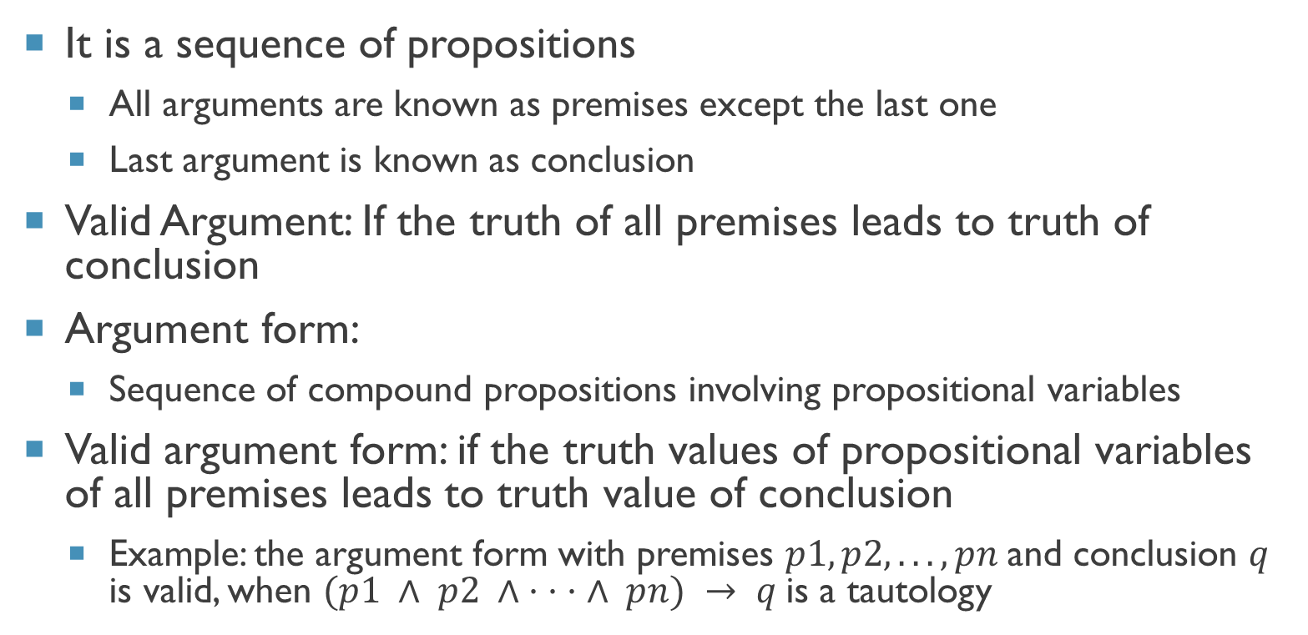
What Is argument
It is a sequence of propositions
All arguments are known as premises except the last one
Last argument is known as conclusion
Valid Argument: If the truth of all premises leads to truth of conclusion
Argument form:
Sequence of compound propositions involving propositional variables
Valid argument form: if the truth values of propositional variables of all premises leads to truth value of conclusion
Example: the argument form with premises $p1, p2, . . . , pn$and conclusion $q$ is valid, when $(p1 ∧ p2 ∧ · · · ∧ pn) → q$is a tautology
Example
$p→q ∧q→r$ Premises: $p,q$ Conclusion: $r$

Slide 6
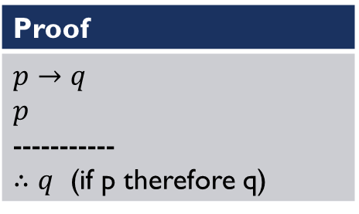
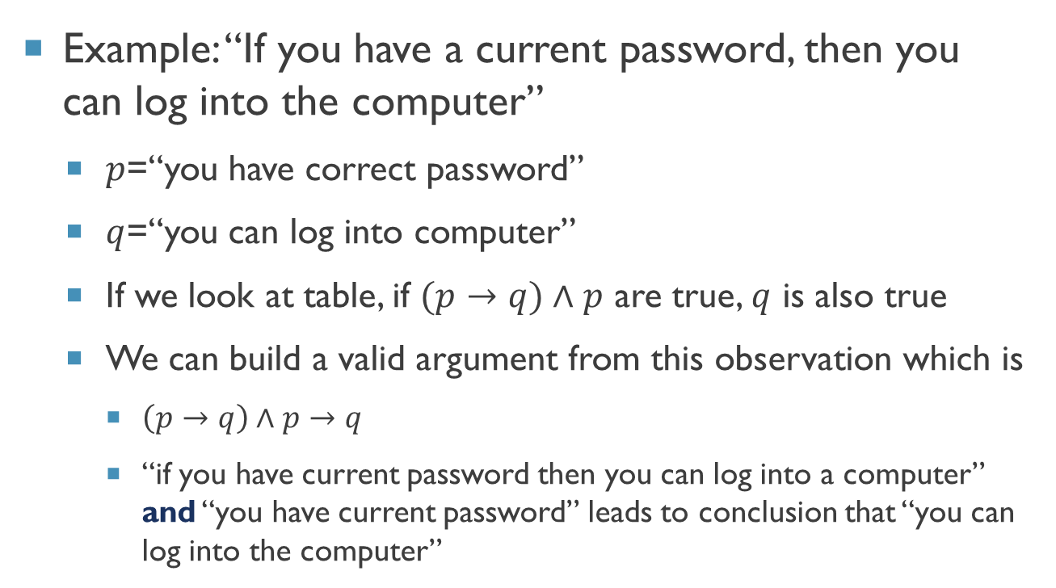
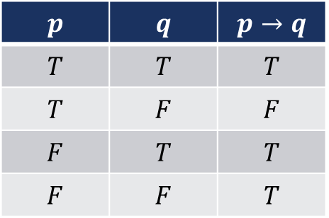
Valid arguments in propositional logic
Example: “If you have a current password, then you can log into the computer”
$p$=“you have correct password”
$q$=“you can log into computer”
If we look at table, if $(p→q)∧p$ are true, $q$ is also true
We can build a valid argument from this observation which is
$\left(p→q\right)∧p→q$
“if you have current password then you can log into a computer” and “you have current password” leads to conclusion that “you can log into the computer”
$$p$$ | $$q$$ | $$p→q$$
$$T$$ | $$T$$ | $$T$$
$$T$$ | $$F$$ | $$F$$
$$F$$ | $$T$$ | $$T$$
$$F$$ | $$F$$ | $$T$$
Proof
$p→q$ $p$ ----------- $∴q$ (if p therefore q)

Slide 7
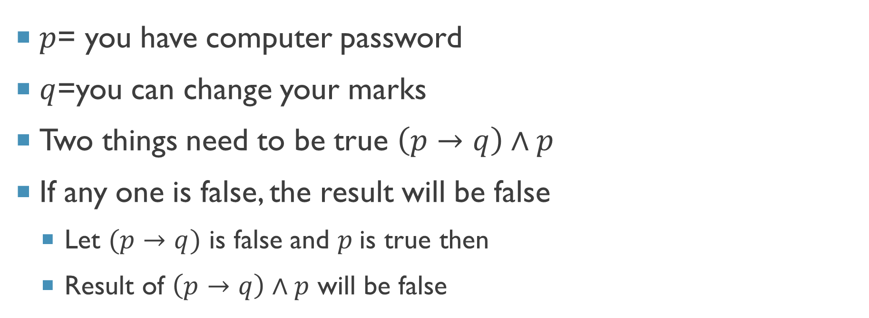
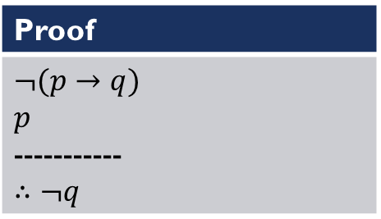
Valid argument - example
$$p$$ | $$q$$ | $$p→q$$
$$T$$ | $$T$$ | $$T$$
$$T$$ | $$F$$ | $$F$$
$$F$$ | $$T$$ | $$T$$
$$F$$ | $$F$$ | $$T$$
$p$= you have computer password
$q$=you can change your marks
Two things need to be true $\left(p→q\right)∧p$
If any one is false, the result will be false
Let $(p→q)$ is false and $p$is true then
Result of $\left(p→q\right)∧p$ will be false
Proof
$¬(p→q)$ $p$ ----------- $∴¬q$

Slide 8
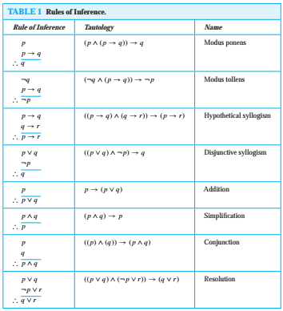
Inference rules in propositional logic

Slide 9
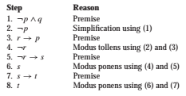
Using Rule of inference to build arguments
When there are many premises, several rules of inference are often needed to show that an argument is valid
Example:
Show that the premises “It is not sunny this afternoon and it is colder than yesterday,” “We will go swimming only if it is sunny,” “If we do not go swimming, then we will take a canoe trip,” and “If we take a canoe trip, then we will be home by sunset” lead to the conclusion “We will be home by sunset.”
Solution
P=It is sunny this afternoon
Q=it is colder than yesterday
R= we will go swimming
S= we will take canoe trip
T=we will be home by sunset
The premises become
And conclusion is T
$$¬p ∧ q, r → p, ¬r → s, and s → t$$

Slide 10

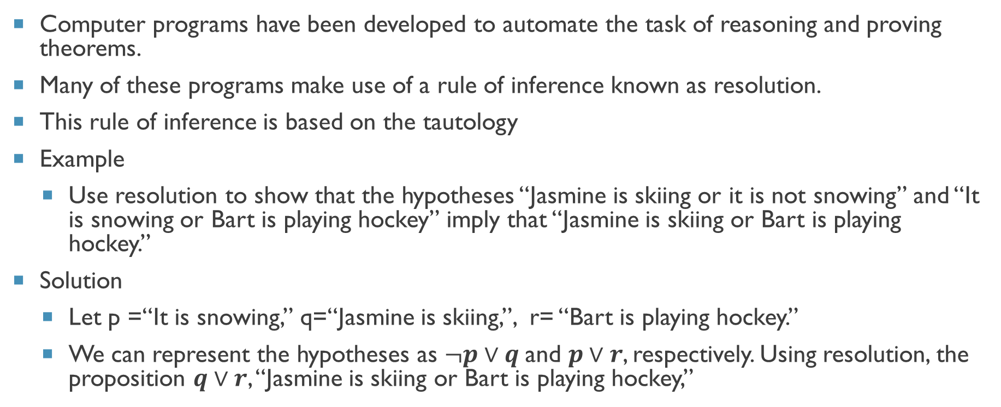
Resolution
Computer programs have been developed to automate the task of reasoning and proving theorems.
Many of these programs make use of a rule of inference known as resolution.
This rule of inference is based on the tautology
Example
Use resolution to show that the hypotheses “Jasmine is skiing or it is not snowing” and “It is snowing or Bart is playing hockey” imply that “Jasmine is skiing or Bart is playing hockey.”
Solution
Let p =“It is snowing,” q=“Jasmine is skiing,”, r= “Bart is playing hockey.”
We can represent the hypotheses as $¬p∨q$and $p∨r$, respectively. Using resolution, the proposition $q∨r$, “Jasmine is skiing or Bart is playing hockey,”
$$((p ∨ q) ∧ (¬p ∨ r)) → (q ∨ r)$$

Slide 11
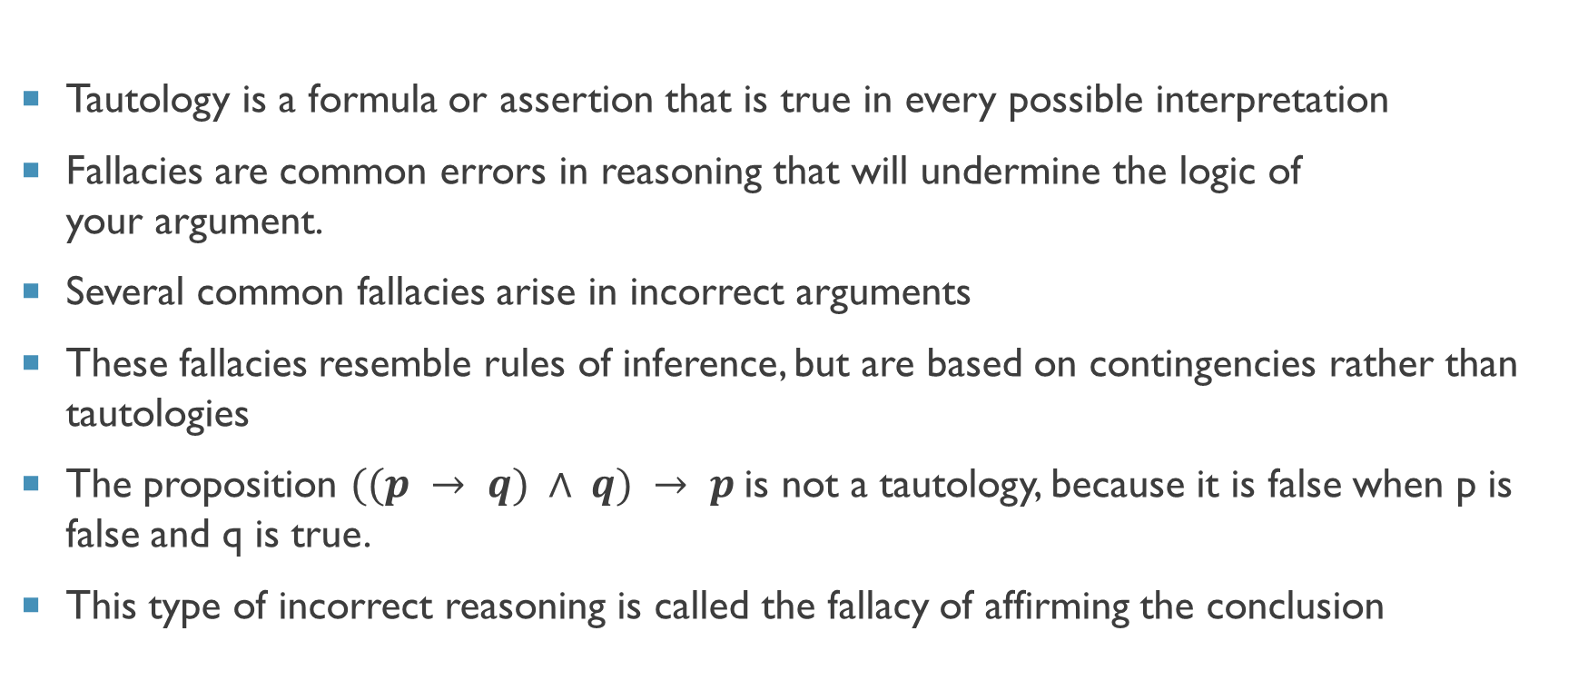
Fallacies
Tautology is a formula or assertion that is true in every possible interpretation
Fallacies are common errors in reasoning that will undermine the logic of your argument.
Several common fallacies arise in incorrect arguments
These fallacies resemble rules of inference, but are based on contingencies rather than tautologies
The proposition $((p → q) ∧ q) → p$is not a tautology, because it is false when p is false and q is true.
This type of incorrect reasoning is called the fallacy of affirming the conclusion

Slide 12
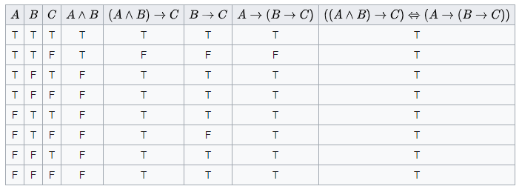
Tautology example

Slide 13
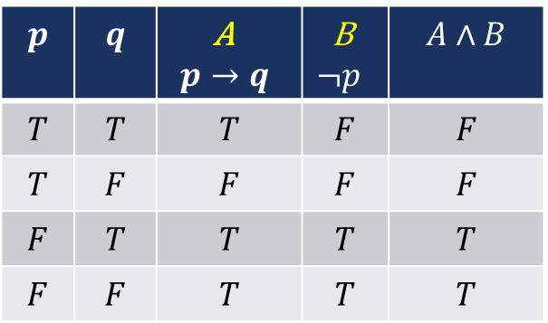
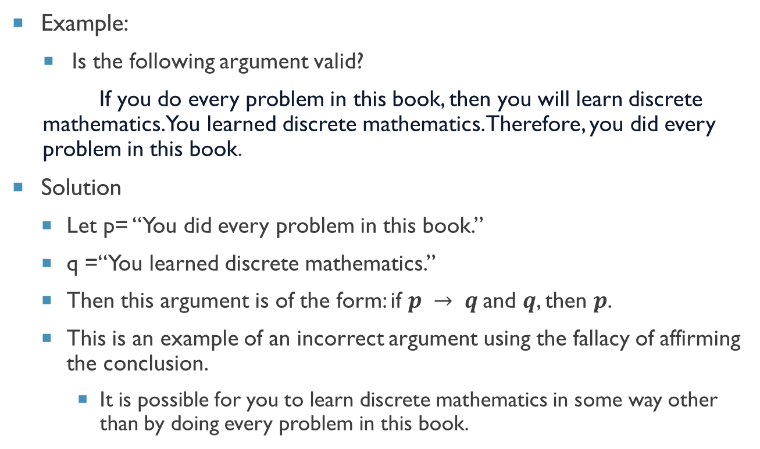
Fallacy
Example:
Is the following argument valid?
If you do every problem in this book, then you will learn discrete mathematics. You learned discrete mathematics. Therefore, you did every problem in this book.
Solution
Let p= “You did every problem in this book.”
q =“You learned discrete mathematics.”
Then this argument is of the form: if $p → q$and $q$, then $p$.
This is an example of an incorrect argument using the fallacy of affirming the conclusion.
It is possible for you to learn discrete mathematics in some way other than by doing every problem in this book.
$$p$$ | $$q$$ | A $$p→q$$ | B $$¬p$$ | $$A∧B$$
$$T$$ | $$T$$ | $$T$$ | $$F$$ | $$F$$
$$T$$ | $$F$$ | $$F$$ | $$F$$ | $$F$$
$$F$$ | $$T$$ | $$T$$ | $$T$$ | $$T$$
$$F$$ | $$F$$ | $$T$$ | $$T$$ | $$T$$

Slide 14
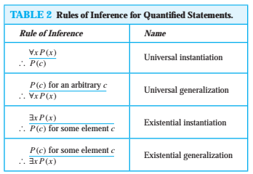
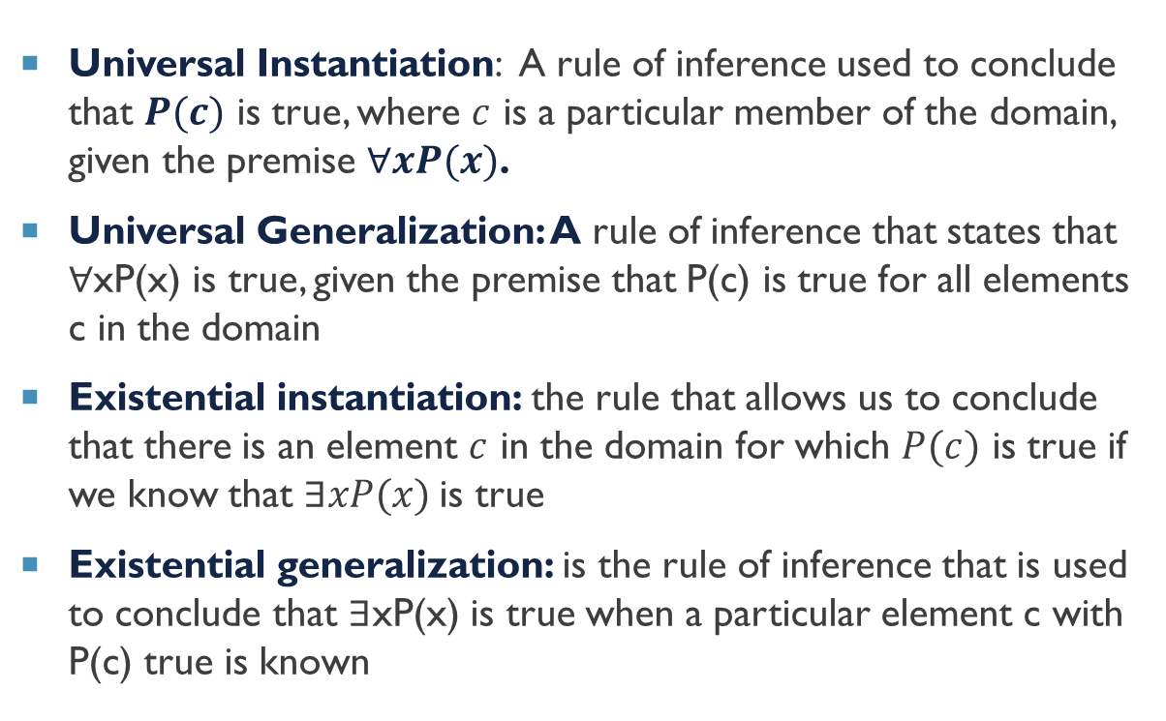
Rule of inference in quantified statements
Universal Instantiation: A rule of inference used to conclude that $P(c)$ is true, where $c$ is a particular member of the domain, given the premise $∀xP(x)$.
Universal Generalization: A rule of inference that states that ∀xP(x) is true, given the premise that P(c) is true for all elements c in the domain
Existential instantiation: the rule that allows us to conclude that there is an element $c$ in the domain for which $P(c)$ is true if we know that $∃xP(x)$is true
Existential generalization: is the rule of inference that is used to conclude that ∃xP(x) is true when a particular element c with P(c) true is known

Slide 15



Thanks for watching
Dr. Sajid Iqbal
Assistant Professor
Department of Computer Science
Bahauddin Zakariya University, Multan
sajidiqbal.pk@gmail.com
https://github.com/sajjo79/DiscreteMathematics
Allah Hafiz
COMEDXD

